Slide 1

ORGANIZATIONAL BEHAVIOUR
Module Four

Slide 2
Performance Appraisal
Defined
An organization’s performance appraisal system is defined as a process which generates valid information about employee work effectiveness for the purpose of making informed human resource decisions.

Slide 3
Why
Performance Appraisal?
Employees must understand the behavioural requirements of the job.
Employees need to know where they stand with the organization in terms of their performance.
Employees’ work must be evaluated for its contributions to organizational goals.

Slide 4
Why
Performance Appraisal?
Valid information about performance levels of the employees should be used to make decisions about salary increases, promotion, bonuses and training needs.
Employees should have a clear understanding of what the organization expects from them in terms of performance.

Slide 5
Why
Performance Appraisal?
Managers can use the performance appraisal system as a motivational tool.
An effective appraisal system creates many opportunities for managers to interact with their subordinates about unit performance standards, organizational goals and personal job interests.

Slide 6
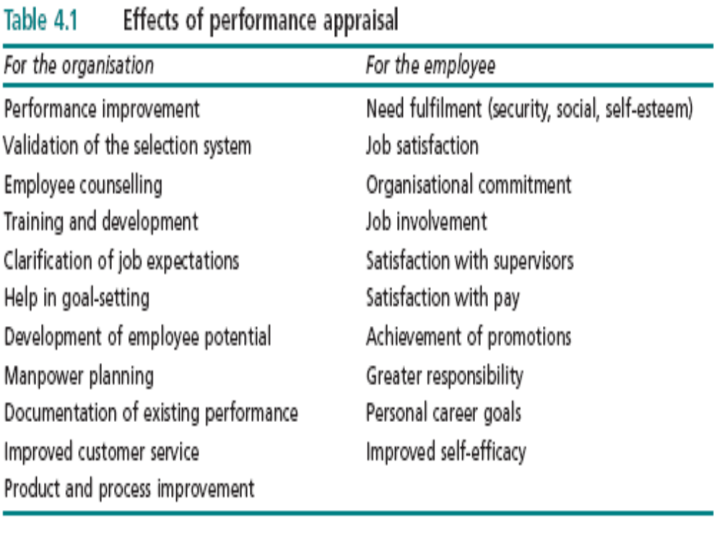

Slide 7
Performance Appraisal
The process of assessment must produce results which are fair, timely and accurate
Deficiency: represents actual performance that is overlooked because the evaluator ignores it or the appraisal system fails to capture it.
  An example : the appraisal system that tracks the frequency of calls handled by representatives& fails to capture the quality of the service & the customer satisfaction.

Slide 8
PERFORMANCE
Unreliability problems
1. Situational factors affecting the evaluator, such as mood or timing of the evaluation
2. Disagreement between evaluators or inconsistent of methods
3. Temporary personal factors, such as fatigue or ill health of the person being evaluated.
Deficiency problem
Performance overlooked
by the evaluator
Deficiency
True
Assessment
( Valid + Reliable)
Unreliability
Invalidity
Validity problem
Poorly defined task performance
Actual
Performance
Measured
Performance

Slide 9
Performance Appraisal
  Unreliability:
  It stems from numerous origins, many of which are in the evaluator (s)
Validity:
is the quality of the measuring components in a performance appraisal system i.e. do the components measure what they are supposed to measure?
Validity is the proven relationship that exists between a selection device and some relevant job criterion

Slide 10
Performance Appraisal
Consistency:
i.e. two or more ways of gathering performance produce results which agree
Stability:
It means that performance measuring items should yield the same score at various evaluation periods if the performance characteristic has not changed
It is the property of dependability of results over time.

Slide 11
Errors in Performance
Appraisal
Personal bias
Halo effect
Recency error
Central tendency error
Strictness or leniency errors
Similarity error
Forcing the rating to match other criteria

Slide 12
Errors in Performance
Appraisal
Personal bias: A stereotype or bias which influence a superior’s rating upward or downward.
Halo effect: Rating an employee on one trait based on other traits. A general impression of an employee based on a single characteristic.

Slide 13
Recency Error:
The emphasis of recent performance examples in making performance assessments
Central Tendency Error:
Assigning average ratings to all employees which causes little variation among ratings.

Slide 14
Errors in Performance
Appraisal
Similarity Error:
The supervisor has a performance quality in himself which he looks for in subordinates.
Forcing the rating to match other criteria:
Deciding on an overall rating first then going back to adjust ratings on the individual dimensions to justify the overall rating.

Slide 15
MBO
Edwin Locke, described the relationship between goals and work performance .
Goals are defined as those end states which reduce the intensity of needs and motives
Clearly specific, difficult goals result in
greater performance than general easy goals.

Slide 16
Goal Setting Systems
Increase work motivation and performance
Reduce the stress of conflicting or confusing expectations
Improve the accuracy and validity of performance evaluation .

Slide 17
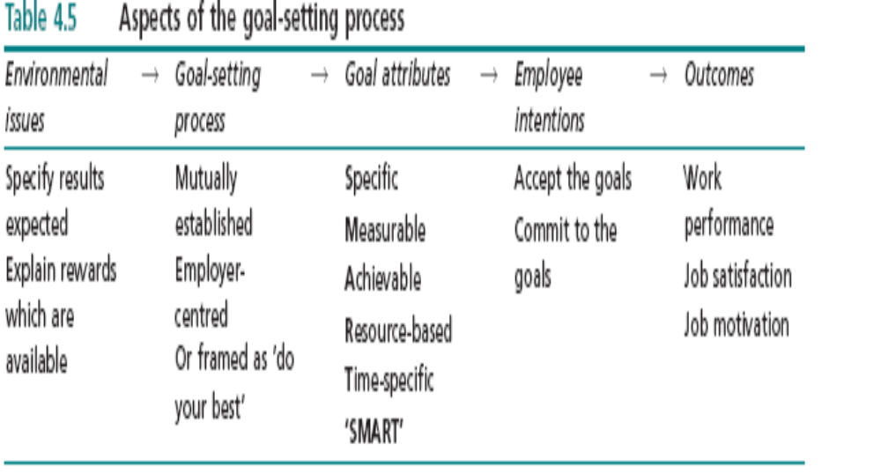
Goal Setting Process

Slide 18
Performance Feedback
Feedback is a highly important element for sustaining the focus of effort towards certain goal.
Organisations must incorporate well timed
formal and informal feedback that keeps managers and employees appraised of their progress .
Feedback is an important intrinsic reward for employees.

Slide 19
MBO
MBO is an application of goal-setting theory.
Peter Drucker. advocates MBO as a process which develops self-control in managers by controlling organizational and individual outcomes.
The mutual acceptance of goal increases the probability that the goal will be achieved and job satisfaction, performance and motivation will occur

Slide 20
WHY MBO
WHY GOAL-SETTING
Increase work motivation and employee job performance.
Reduce the stress of conflicting or confusing work expectations for employees.
Improve the accuracy and validity of performance evaluation work in the organization.

Slide 21
ASSUMPTIONS
OF MBO CYCLE
Employees perform better when they know what is expected of them.
Employees prefer self-determination at work.
Employees can be motivated by further well-timed formal and informal feedback .
Employees prefer intrinsic and extrinsic rewards that are consistent with their performance level.

Slide 22
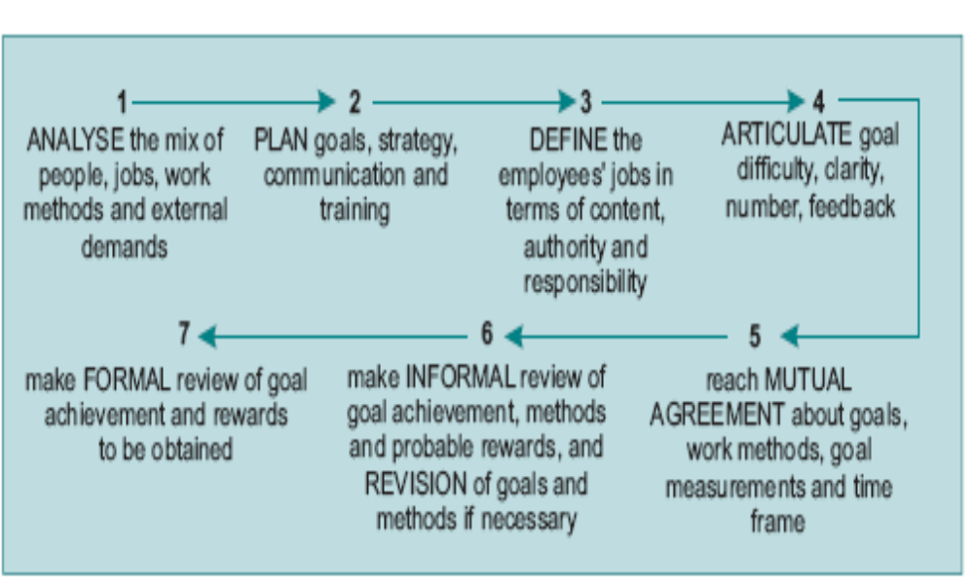
The MBO Cycle

Slide 23
THE 7 MBO STEPS
ANALYSE
The mix of people, jobs, work methods and external demands.
This is a strategic activity conducted by top level management.
2) PLAN
Goals strategy, communication and training

Slide 24
THE 7 MBO STEPS
3) DEFINE
The employees’ job in terms of content, authority and responsibility
4)ARTICULATE
goal difficulty, clarity, number, feedback

Slide 25
THE 7 MBO STEPS
MUTUAL AGREEMENT:
Reach mutual agreement about goals, work methods, goal measurements and time frame
6) INFORMAL REVIEW:
Make informal review of goals achievement, methods and rewards and revision of goals and methods if necessary
7) FORMAL REVIEW:
Make formal review of goal achievement and rewards to be obtained.

Slide 26
The Use of MBO Systems
1- Top management support, commitment and involvement.
2- MBO must have a strong relationship with managerial activities and responsibilities.
3- MBO must emphasise organisational and personal development goals.

Slide 27
The Use of MBO Systems
4-The firm must devote resources to the training of personnel
5-The firm must tailor the MBO system to meet the needs of departments.
6-Managers must avoid overemphasis on the number of goals. The ‘80–20 rule’ is good.

Slide 28
The Use of MBO Systems
7- The benefits of an MBO system should exceed the costs in terms of paperwork.
8- Equal emphasis should be placed on discussion and evaluation.
9- MBO should be flexible and goals can be adjusted to meet unforeseen circumstances.

Slide 29

SMART OBJECTIVES
Specific
Measurable
Achievable
Rsource-based
Time-based

Slide 30
Rewards
Rewards strongly influence employee effort and performance levels.
The perceived equity of these comparisons leads to experienced levels of job satisfaction and motivation.
How the rewards are perceived can easily outweigh the actual rewards distributed by the firm.

Slide 31
CLASSIFYING REWARDS IN WOK SETTING
A. EXTRINSIC REWARDS
Extrinsic rewards are given to the employee by the organization.
Extrinsic rewards can be further broken down into direct compensation, indirect compensation and non-financial rewards.

Slide 32
CLASSIFYING REWARDS IN WOK SETTING
A. EXTRINSIC REWARDS
Direct compensation refers to extrinsic rewards which include
base salary
Bonus
holiday pay
stock options
pensions

Slide 33
CLASSIFYING REWARDS IN WOK SETTING
A. EXTRINSIC REWARDS
Indirect compensation refers to rewards that are given because of the employee’s organizational level rather than because of his performance.
Examples: top executive personal protection programs, loans at low interest rates, and time-off with pay.

Slide 34
CLASSIFYING REWARDS IN WOK SETTING
A. EXTRINSIC REWARDS
Non-financial compensation:
preferred office furniture
parking spaces
own secretary
impressive titles.

Slide 35
CLASSIFYING REWARDS IN WOK SETTING
B. INTRINSIC REWARDS
Intrinsic rewards are rewards which employees associate with the job itself.
These include more responsibility or interesting work, being included in the decision making process, opportunities for personal growth or doing
work which requires a number of skills and activities.

Slide 36
CLASSIFYING REWARDS IN WOK SETTING
B. INTRINSIC REWARDS
Examples of work with high levels of intrinsic rewards include doctors, politicians, judges and designers.( require several skills & activities)
The contrast in available intrinsic rewards is noticeable when you compare these professions with work done by employees in a car factory

Slide 37
CLASSIFYING REWARDS IN WOK SETTING
B. INTRINSIC REWARDS
intrinsic rewards are more important than extrinsic rewards in influencing motivation and performance.
Employees will value goal setting more if they know that participation in the process will lead to intrinsic and extrinsic rewards that they value.

Slide 38
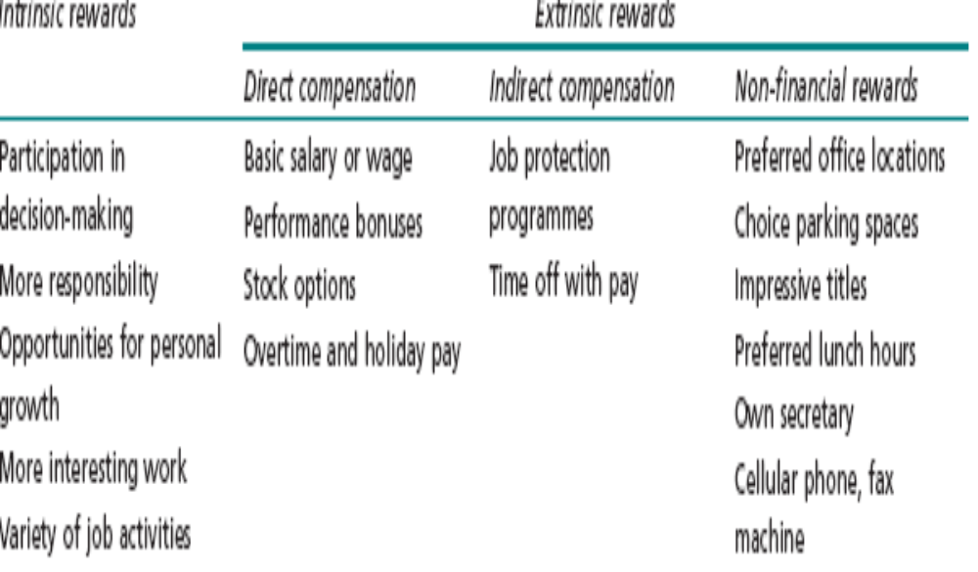
Intrinsic and Extrinsic Rewards in Organizations

Slide 39
DISTRIBUTING REWARDS, HOW?
1) PERFORMANCE
2) EFFORT
3) SENIORITY
4) EQUALITY
5) POWER AND INFLEUNCE

Slide 40
DISTRIBUTING REWARDS
1- PERFORMANCE
When rewards are allocated on this basis, then performance becomes a motivator.

Slide 41
DISTRIBUTING REWARDS
2- EFFORT
In order to minimize turnover and hiring costs, organizations frequently decide to rewarded effort.
This is done to prevent employee from experiencing job dissatisfaction.
Managers reward efforts in the hope that efforts will be followed by actual performance.

Slide 42
DISTRIBUTING REWARDS
2- EFFORT
This is a non-performance basis for allocating rewards.
If the practice is widespread, high performers may experience reduced satisfaction with pay because they believe the organization is neglecting to reward their proven abilities to produce.

Slide 43
DISTRIBUTING REWARDS
3- SENIORITY
Length of service is used to group employees.
When seniority becomes a substitute for performance in the allocation of rewards, the organization soon learns it is encouraging tenacity rather than performance.
This eliminates perceived equity for high performers who leave the organization .

Slide 44
DISTRIBUTING REWARDS
4- EQUALITY
This policy of compensation means that employees at given organizational levels receive the same base pay and pay rises. This is common in partnership.

Slide 45
DISTRIBUTING REWARDS
5- POWER AND INFLUENCE
Groups or individuals are able to increase their share of rewards at the expense of other groups or individuals.
it is a focal concern to unions which wish to preserve their economic capacity to influence employers’ decision.

